Slide 1

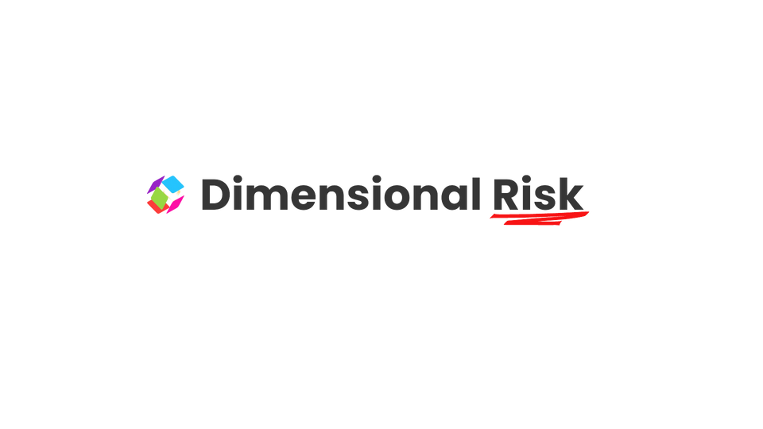
Managing Cyber Risk in a Digital Age: Integrating COSO ERM Framework
Nathi Khanyisile
nathi@keydimensions.co.za
dimensionalrisk.com

Slide 2

Contents
1. Introduction
2. Understanding the COSO ERM Framework
3. Governance and Culture
4. Strategy and Objective Setting
5. Performance
6. Review and Revision
7. Information, Communication, and Reporting
8. Top 10 Cyber Attacks and Incident Responses
9. Integrating COSO ERM into Cyber Security Practices
10. Conclusion

Slide 3

Introduction
The evolving digital landscape has brought increased connectivity, automation, and innovation to businesses across industries. However, it has also introduced sophisticated cyber risks that threaten operational continuity, data integrity, and stakeholder trust.
To address these risks, companies need a comprehensive approach that not only focuses on technical solutions but also aligns with overall enterprise risk management (ERM). The COSO ERM framework provides this integrated structure, enabling organizations to identify, assess, and manage cyber risks in a strategic and holistic manner.

Slide 4
Understanding the COSO ERM Framework
The COSO ERM framework emphasizes integrating risk management across business operations, creating a cohesive strategy that enables organizations to handle uncertainties and enhance resilience. By applying COSO ERM principles to cyber security, businesses can proactively mitigate threats and better respond to incidents.
( insert image of COSO ERM FRAMEWORK)

Slide 5




Governance and Culture
Setting the Tone for Cyber Risk Management
Board Risk Oversight
Operating Structures
The board should have clear visibility and oversight over the organization’s cyber security posture. This includes allocating resources and setting the right tone at the top.
Establish governance structures where the compliance and IT security teams collaborate to manage cyber threats.
Risk-Aware Culture
Cyber Security Integration
Cultivating a risk-aware culture is crucial. Continuous education and training empower employees to identify and respond to cyber threats like phishing, malware, and social engineering.
Governance and culture serve as the foundation for a robust cyber security strategy. Establish policies that promote secure practices, enforce compliance, and make security a shared responsibility across the organization.

Slide 6
Strategy and Objective Setting
Aligning Cyber Security with Business Goals
Analyzing Business Context
Defining Risk Appetite
Understand the internal and external factors that impact the organization’s exposure to cyber risks. This includes industry trends, regulatory changes, and technological advancements.
Clearly articulate the organization’s tolerance for cyber risks, helping prioritize resource allocation.
( insert image to trigger emotional response )
( insert image to trigger emotional response )
Cyber Security Integration
Aligning Objectives
Ensure cyber security objectives are aligned with overall business goals, balancing protection with the need for innovation and growth.
A cyber security strategy should align with the broader risk management framework, setting clear objectives for data protection, incident response, and compliance.
( insert image to trigger emotional response )
( insert image to trigger emotional response )

Slide 7
Performance
Managing and Responding to Cyber Threats
Identifying and Assessing Risks
Risk Prioritization
Develop a risk inventory identifying all potential cyber threats, including malware, phishing, ransomware, and Denial of Service (DoS) attacks.
Rank risks based on their likelihood and potential impact. Prioritize threats to sensitive data and critical systems.
( insert image to trigger emotional response )
( insert image to trigger emotional response )
Implementing Controls
Cyber Security Integration
Implement preventative measures such as firewalls, intrusion detection systems, and regular software updates to minimize cyber attack risks.
A proactive approach to risk performance involves continuous monitoring of cyber threats. Utilize analytics and threat intelligence to identify vulnerabilities and test systems regularly to ensure control effectiveness.
( insert image to trigger emotional response )
( insert image to trigger emotional response )

Slide 8
Review and Revision
Adapting to the Evolving Threat Landscape
Monitoring and Revising Controls
Continuously monitor the effectiveness of cyber security measures. Revise policies and strategies as new threats emerge.
Adapting to Change
As the cyber threat landscape evolves, so should risk management strategies. Organizations should adapt to new attack types, such as ransomware variants or advanced social engineering tactics.
Cyber Security Integration
Treat cyber security as an ongoing process, regularly updating security policies, conducting audits, and addressing new vulnerabilities.
( insert background image to trigger emotional response )

Slide 9
Information, Communication, and Reporting
Ensuring Transparency and Accountability
Leveraging Technology for Communication
Two-Way Communication Channels
Use technology to facilitate communication about cyber risks across the organization.
Establish clear communication channels for reporting suspicious activities and sharing best practices.
Reporting on Performance
Cyber Security Integration
Provide tailored reports to stakeholders outlining cyber risk management performance, highlighting areas for improvement.
Effective communication is essential for maintaining a strong cyber security posture. Create a culture of transparency where employees can report incidents without fear of retribution.
( insert background image to trigger emotional response )

Slide 10

( insert background image to trigger emotional response )
Top 10 Cyber Attacks and Incident Responses
  Malware
  Phishing Attack
  SQL Injection
  Ransomware
  Denial of Service (DoS)
  Cross-Site Scripting (XSS)
  Distributed Denial of Service (DDoS)
  Man-in-the-Middle (MitM)
  Social Engineering
  Drive-by Download

Slide 11
1 Malware
( insert background image to trigger emotional response )
Incidence
Malware infiltrates systems by deceiving users into downloading malicious software or clicking on harmful links. It can propagate, steal data, and compromise systems.
Response
Isolate affected systems, conduct malware scans, remove threats, restore data from backups, patch vulnerabilities, and implement a detection and response plan.
Risk Management Tip
Educate employees on identifying phishing attempts and suspicious downloads.
2 Ransomware
( rearrange spacing of #1 and #2 or shorten the sentences and speak from notes )
Incidence
Ransomware encrypts data, demanding a ransom for the decryption key, leading to operational halt and financial loss.
Response
Isolate affected systems, avoid paying ransom, restore data from backups, patch systems, and develop a response plan.
Risk Management Tip
Regularly back up critical data and store backups offline.

Slide 12
3 Phishing Attack
Incidence
Response
Risk Management Tip
Attackers impersonate trusted entities to trick users into clicking on malicious links or opening attachments.
Train users, verify sources, employ multi-factor authentication, and review logs for unauthorized access.
Enhance email filtering and conduct regular phishing simulations.
4 SQL Injection
Incidence
Response
Risk Management Tip
Attackers exploit vulnerabilities by inserting malicious SQL code into a backend database to manipulate data or gain access.
Implement input validation, conduct security updates, and review database activities.
Adopt secure coding practices.
( insert background image to trigger emotional response )

Slide 13
5 Denial of Service (DoS)
Incidence
Response
Risk Management Tip
DoS attacks overwhelm a network or service to render it unavailable by flooding it with traffic.
Block attackers' IPs, apply rate limiting and traffic filtering, collaborate with ISPs, and review logs.
Engage a content delivery network (CDN) to absorb traffic.
6 Distributed Denial of Service (DDoS)
Incidence
Response
Risk Management Tip
DDoS attacks involve multiple systems sending numerous requests to overwhelm and shut down targets.
Engage DDoS protection services, utilize load balancers, and coordinate with ISPs.
Implement a DDoS incident response plan with traffic monitoring and filtering.
( insert background image to trigger emotional response )

Slide 14
7 Cross-Site Scripting (XSS)
Incidence
XSS attacks inject malicious scripts into websites to access cookies, session tokens, and sensitive information.
Response
Sanitize inputs, update applications, inform users, and emphasize secure browsing.
Risk Management Tip
Utilize web application firewalls (WAF).
8 Man-in-the-Middle (MitM)
Incidence
Attackers intercept communications between parties to access or manipulate data.
Response
Notify users, use encryption (SSL/TLS), and monitor network traffic.
Risk Management Tip
Encourage VPN use for securing external connections.
( insert background image to trigger emotional response )

Slide 15
9 Social Engineering
Incidence
Social engineering manipulates individuals to divulge confidential information through impersonation or psychological tricks.
Response
Conduct training, implement identity verification, and review access logs.
Risk Management Tip
Update security awareness programs regularly.
( insert background image to trigger emotional response )
10 Drive-by Download
Incidence
Users inadvertently download malicious software from compromised websites.
Response
Scan and remove malware, update systems, educate users on safe browsing.
Risk Management Tip
Utilize endpoint security solutions with real-time scanning.

Slide 16
Integrating COSO ERM into Cyber Security Practices
Integrating COSO ERM into cyber security is not just about technology but creating a robust, structured approach to managing risk. By focusing on governance, culture, strategic alignment, continuous monitoring, and effective communication, organizations can build a resilient cyber security posture that protects their assets, ensures compliance, and supports long-term business objectives.
( insert background image to trigger emotional response )

Slide 17
Conclusion
The COSO ERM framework provides a roadmap for organizations to follow, ensuring that cyber security strategies are not only reactive but proactive and aligned with the overall risk management approach. By adopting this integrated model, businesses can navigate the complex cyber threat landscape with confidence and agility, safeguarding their assets, reputation, and operational resilience.
( insert background image to trigger emotional response )
( include contact info and bio i.e the same as the cover page)
( summarize intro, body to make conclusion)
( smile , thank the audience )
( have a Q &A)

