Slide 1

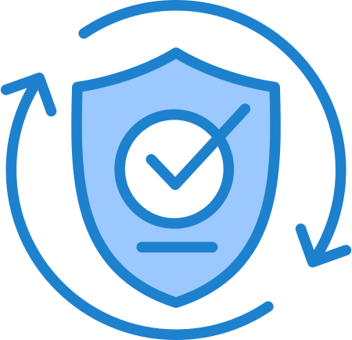
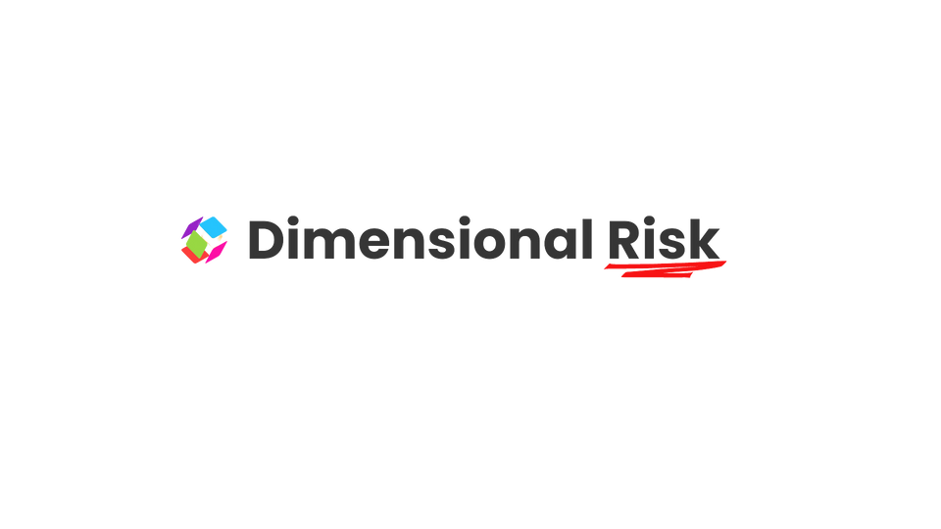
Compliance Risk Management: Applying the COSO ERM Framework
Nathi Khanyisile
nathi@keydimensions.co.za
dimensionalrisk.com

Slide 2

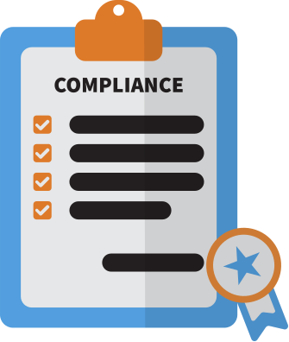
Contents
( feel free to include which topic belongs to which page)
1. Introduction
2. Compliance Risks
3. Elements of an Effective Compliance Program
4. COSO ERM Framework Components
5. Governance and Culture for Compliance Risks
6. Strategy and Objective-Setting for Compliance Risks
7. Compliance Risk Management Performance
8. Reviewing and Revising Compliance Risk Management
9. Information, Communication, and Reporting
10. Conclusion

Slide 3

Introduction
( explain COSO or ERM or similar organization if audience not familiar )
Compliance risks are common and significant threats to achieving organizational objectives. This presentation provides guidance on applying the COSO ERM framework to identify, assess, and manage compliance risks aligned with Compliance & Ethics (C&E) programs.
Compliance risks include breaches of laws, regulations, and internal policies, and their mismanagement can lead to severe organizational consequences, including financial and reputational damage.

Slide 4


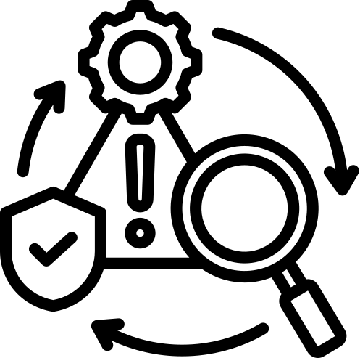

Compliance Risks
Definitions and Scope
Risk Definition
Types of Risks
Examples
(give an everyday definition)
( simplify with the types then exapnd )
( give contextual examples )
Defined as the possibility of events affecting the achievement of business objectives, including compliance.
Compliance risks related to laws, regulations, contractual terms, and internal policies. Compliance-related risks include violations of standards, organizational policies, and ethical guidelines.
Violations affecting customers (privacy breaches), employees (safety violations), and the general public (environmental breaches).

Slide 5




Elements of an Effective Compliance Program
1. Standards and Procedures
2. Governance and Oversight
Establish standards to prevent and detect
criminal conduct.
Involving the board, management, and the compliance officer.
( expand with reading notes)
( expand with reading notes)
3. Due Diligence
4. Communication and Training
Perform background checks to avoid hiring individuals with a history of illegal activities.
Implement effective training programs and disseminate information.
( expand with reading notes)
( expand with reading notes)

Slide 6
COSO ERM Framework Components
1. 1. Governance & Culture
Set appropriate tone, carry out risk oversight.
2. 2. Strategy & Objective-Setting
Define risk appetite, assess business context.
3. 3. Performance
Identify, assess, and prioritize risks.
4. 4. Review & Revision
Continually improve the enterprise risk management process.
5. 5. Information, Communication & Reporting
Communicate and report risk information effectively.
( expand with reading notes)
( expand with reading notes)
( expand with reading notes)
( expand with reading notes)
( expand with reading notes)

Slide 7
Governance and Culture for Compliance Risks
1. 1. Board Risk Oversight
Board should oversee compliance programs and ensure resource allocation.
2. 2. Operating Structures
Ensure the compliance function has high stature and authority.
3. 3. Desired Culture
Promote a risk-aware culture and provide comprehensive training.
4. 4. Commitment to Core Values
Embed compliance into the organization's core values and culture.
5. 5. Attracting Capable Individuals
Hire and retain individuals committed to compliance and ethics.
( expand with reading notes)
( expand with reading notes)
( expand with reading notes)
( expand with reading notes)
( expand with reading notes)

Slide 8
Strategy and Objective-Setting for Compliance Risks
Steps and Principles
1. Analyzing Business Context
2. Defining Risk Appetite
Evaluate internal & external factors affecting compliance risks.
Discuss and determine acceptable levels of compliance risk.
( expand with reading notes and/or give examples)
( expand with reading notes and/or give examples)
3. Evaluating Strategies
4. Formulating Business Objectives
Assess compliance risks related to strategy options.
Ensure compliance and performance objectives are aligned.
( expand with reading notes and/or give examples)
( expand with reading notes and/or give examples)

Slide 9
Compliance Risk Management Performance
1. 1. Identifying Risks
Develop a risk inventory using various identification methods.
2. 2. Assessing Risk Severity
Evaluate risks based on likelihood and impact.
3. 3. Prioritizing Risks
Rank risks based on their assessments and impact on business objectives.
4. 4. Implementing Responses
Design and apply appropriate risk responses, including control enhancements.
5. 5. Developing Portfolio View
Consider interrelationships between compliance risks.
( define point and/or give examples)
( define point and/or give examples)
( define point and/or give examples)
( define point and/or give examples)
( define point and/or give examples)

Slide 10

Reviewing and Revising Compliance Risk Management
Challenges and Improvements
1. Assessing Changes
( add contextual examples )
Monitor internal and external changes affecting compliance risks.
2. Reviewing Performance
( add contextual examples )
Conduct periodic reviews and assessments of the C&E program.
3. Pursuing Improvements
( add contextual examples )
Implement action plans based on review outcomes.

Slide 11



Information, Communication, and Reporting
Principles and Practices
1. Leveraging Technology
2. Communicating Risk Information
3. Reporting on Risks and Performance
( list current examples )
( list techniques)
( list techniques)
Use technology for training, monitoring, and data analytics.
Maintain a two-way communication channel about compliance risks.
Provide tailored reports to stakeholders on compliance risk management.

Slide 12


Conclusion
Effective compliance risk management using the COSO ERM Framework helps organizations align compliance activities with broader risk management practices. Through establishing robust oversight, clear policies, risk-aware culture, continuous learning, and leveraging technology, organizations can better manage compliance risks, thereby minimizing potential adverse impacts.
( summarize intro, body to make conclusion)
( smile , thank the audience )
( have a Q &A)

